Slide 1
16.216
ECE Application Programming
Instructor: Dr. Michael Geiger
Fall 2013
Lecture 5:
PE1: Flowcharts and debugging

Slide 2
Lecture outline
Announcements/reminders
  Program 2 due 9/16
  Sign up for the course discussion group
Review
  Basic input with scanf()
  Output formatting
Today’s lecture
  PE1: Flowcharts and debugging
ECE Application Programming: Lecture 4

Slide 3
Review: scanf()
To read input, use format specifiers in scanf() format string, followed by addresses of variables
  scanf("%d %f",&hours,&rate);
ECE Application Programming: Lecture 3

Slide 4
Formatted output: field width
Specifying field width (min # characters) (assume n = 12):
  printf(“%10d”, n); → 12 (8 spaces, then number 12)
To left justify value in field, use – flag before width
  printf(“%-10d”, n); → 12________ (Number 12, then 8 spaces)
To force the sign to show, use + flag before width
  printf(“%+10d”, n); → +12
  (7 spaces, a plus sign, then number 12)
To place 0s before the value, use 0 flag before width
  printf(“%010d”, n); → 0000000012
  printf(“%+010d”, n); → +000000012
  printf(“%-010d”, n); → 12________
To use a variable to specify field width, use * as the width
  printf(“%*d”, n, n); → 12
  (Field width = 12 → 10 spaces, then the number 12)
Field width never truncates
  printf(“%1d”, n); → still prints 12
ECE Application Programming: Lecture 3

Slide 5
Formatted output: precision
For examples, int n = 12; double x = 3.754
Specifying precision:
  # chars after decimal point for FP (%f, %lf)
    Rounds last digit
    printf(“%.6lf”, x); → 3.754000
    printf(“%.1lf”, x); → 3.8
    printf(“%.0lf”, x); → 4
  Minimum # chars for integer (%d, %i, %u, %x)
    Does not truncate; will pad with leading 0s
    printf(“%.1d”, n); → 12
    printf(“%.3d”, n); → 012
  Max # chars for string (%s)
    printf(“%.5s”, “one”); → one
    printf(“%.5s”, “one two”); → one t
  No effect for char (%c)
As with field width, can use * to specify that field width is a variable
ECE Application Programming: Lecture 3

Slide 6
Flowcharts
Graphical representation of process
  Shows all steps and their order
  In programming, use to organize program before writing code
Basic elements
Process
Terminator (start/end)
Input/Output
Connector
Decision
Connector (off page)
ECE Application Programming: Lecture 2

Slide 7

Example: Quadratic Equation Solver
Start
Output
“Quadratic Equation Solver”
Output
“Enter A, B, C: ”
Input A, B, C
ECE Application Programming: Lecture 2

Slide 8

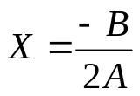

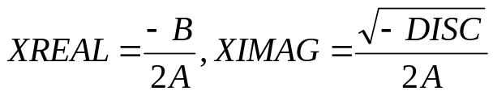
Quadratic Equation Solver (cont.)
A = 0?
TRUE
Output
X
FALSE
DISC=B*B-4*A*C
DISC = 0?
TRUE
Output
X
FALSE
DISC>0?
TRUE
Output
X1,X2
FALSE
Output
XREAL + XIMAG i
XREAL – XIMAG i
ECE Application Programming: Lecture 2
Done

Slide 9
Exercise: Flowchart
Design a flowchart to solve the following:
  Prompt a user to enter four numbers on a single line, which represent the contents of a 2x2 array
  After reading the values, your program should print the matrix represented by these values
    For example, if the user enters “1 2 3 4”, print:
  1 2
  3 4
    Assume all values have the same number of digits
  Also, calculate the matrix discriminant and print it on a separate line
    In the example above, discriminant = (1x4) - (2x3) = 4-6 = -2
ECE Application Programming: Lecture 2

Slide 10
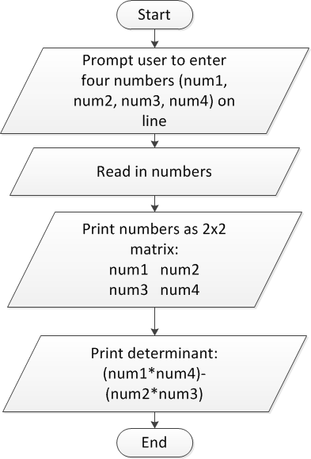
Flowchart: solution
ECE Application Programming: Lecture 2

Slide 11
Converting flowchart to program
What data are used in the process?
  Can those data be represented as constants?
  If not, what variables are needed?
    How many?
    What type(s)?
    How should variables be named?
What C statement corresponds to each process step?
  Input statements: scanf()
  Output statements: printf()
  Terminators: start/end of main() function
    Will generalize later to any function
  General process steps: basic expressions
    May need multiple lines of code
ECE Application Programming: Lecture 2

Slide 12
Debugging
Most IDEs allow ability to view state of program while running through debugger
  View variable values
  Execute program:
    One line at a time (single step)
    By running until reaching a pre-defined stopping point (breakpoint)
Can isolate bugs without altering program
  Alternate solution: inserting print statements to show program state at various points
  Disadvantages
    Inefficient--repeated compilation, must keep adding statements
    May actually alter operation of other statements
ECE Application Programming: Lecture 2

Slide 13
Debugger demonstration
Demonstration of Visual Studio debugger
  Variables
    Watch window
    Autos window
    Locals window
  Single step options
    Step over
    Step into/step out
  Breakpoints
    Setting breakpoints
    Running to next breakpoint
ECE Application Programming: Lecture 2

Slide 14
Final notes
Next time
  Conditional statements: if
Reminders:
  Sign up for the course discussion group on Piazza!
  Program 2 due 9/16
ECE Application Programming: Lecture 4

